Slide 1




YIELDLENS: STABILITY-AWARE SENSOR REDUCTION FOR SEMICONDUCTOR YIELD MONITORING USING
CHRONOLOGICAL DRIFT VALIDATION
Karthick S
Author
Karthikeyan S
Author
Vidhursh Kumar V
Co - Author
Selvarani K
Co - Author

Slide 2
Problem Statement
Existing feature selection methods rank sensors using a single snapshot of data, assuming that sensor importance remains constant over time. However, in semiconductor manufacturing, sensor behavior changes due to process drift, making these methods unreliable for long-term fault prediction. This challenge is further compounded by the highly imbalanced nature of the data, where failure samples are rare.
Key Challenges
Identifying a small set of sensors that stays predictive over time, not just in one snapshot — while also not discarding rare but critical sensors that only "activate" during failure events.
Research Gap
Most SECOM studies perform static feature selection using a single train-test split. The timestamp information is largely ignored, despite process changes over time.
Existing stability-selection methods test robustness through random sampling, not real chronological process drift.
Research Objective
To design a sensor reduction method that selects sensors based on their predictive stability across chronologically ordered time batches, rather than importance on a single snapshot — producing a smaller, drift-aware sensor shortlist that is at least as reliable as the full sensor set.

Slide 3
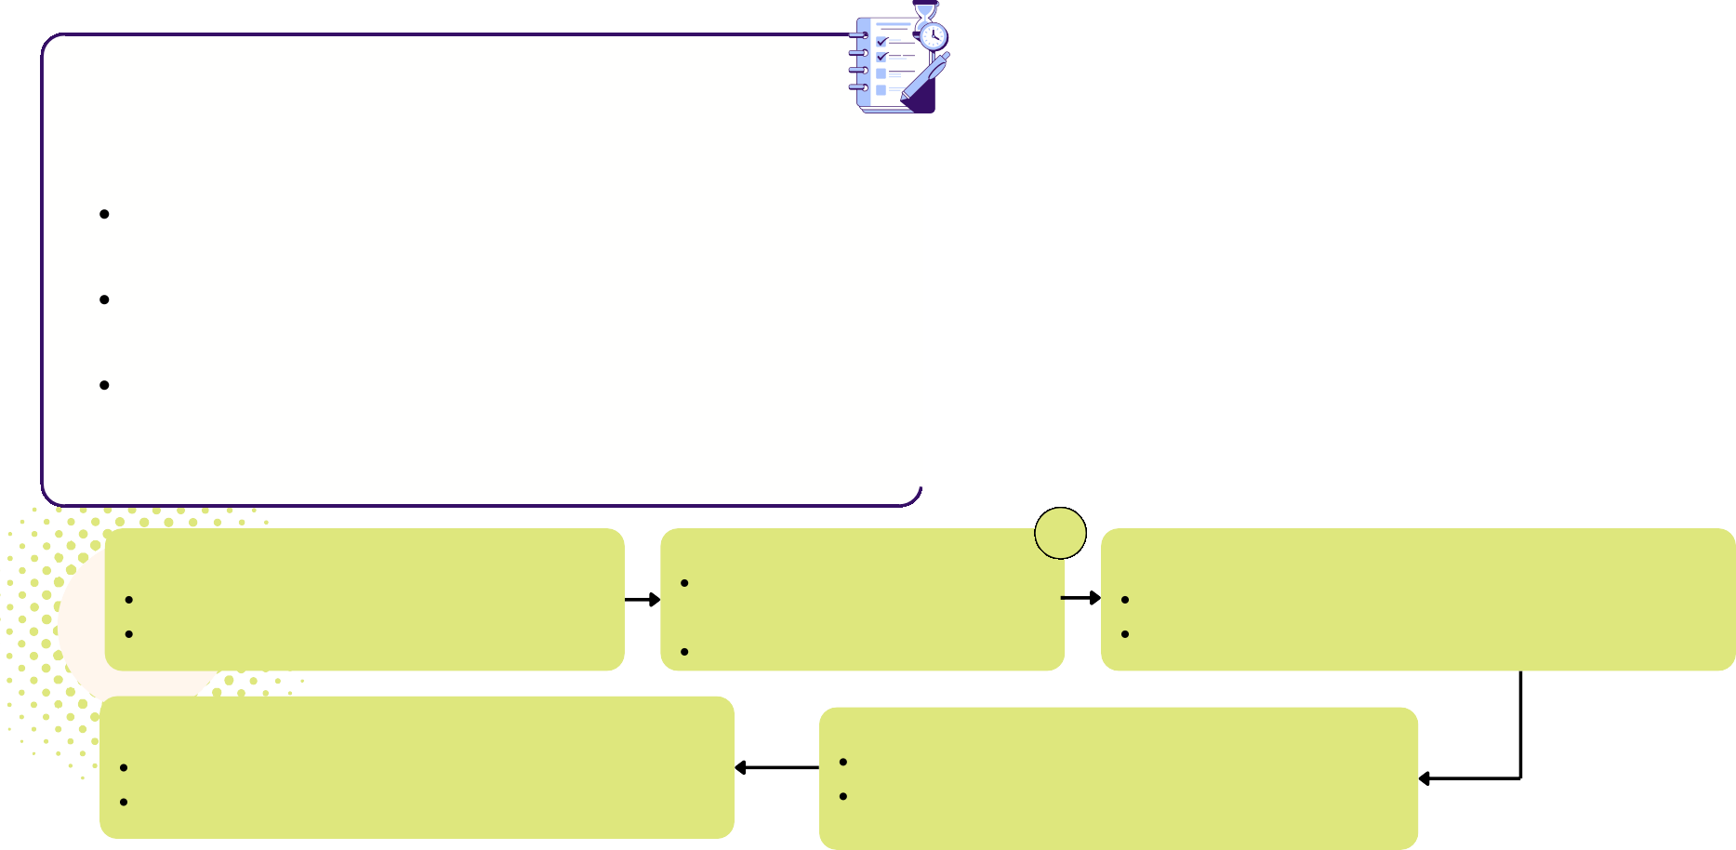


Dataset & Preprocessing
Dataset: SECOM (UCI Machine Learning Repository)
Total records: 1,567 wafers
Features
Original: 590 sensor readings (+ timestamp + pass/fail label)
After tripwire audit: 128 near-constant sensors flagged, 2 whitelisted
Final shortlist: 17 sensors
Outcome classes: 2 (Pass / Fail) — class imbalance ~93:7 (fail rate ~6.6%)
Data Split
Chronological Batching: 5 sequential, non-overlapping batches.
Train/Test Split: Batches 0–3 for training, Batch 4 for testing.
Class Imbalance: SMOTE on training data only; class weighting during LASSO
Preprocessing Pipeline
Missing Value Handling Per-sensor median imputation Preserved all 590 sensors
Duplicate / Leakage Prevention Chronological batching (no random shuffling)
Prevented future data leakage
Feature Selection & Reduction LASSO per batch → Stability Score
Tripwire Audit rescues rare but important sensors
Chronological Splitting
Past → Future evaluation Simulates real-world deployment
Feature Scaling Applied within each training batch Prevented scaling leakage across time

Slide 4

Literature Review & Research Gap
Paper | Approach | Limitation | Our Work (YieldLens)
McCann & Johnston (2008) | Baseline SECOM feature selection | Static single split | Chronological batching on all 590 sensors
Guyon & Elisseeff (2003) | Feature selection survey | No temporal analysis | Drift-aware embedded feature selection
Tibshirani (1996) | LASSO feature selection | No stability over time | LASSO applied across time batches
Meinshausen & Bühlmann (2010) | Stability selection | Random resampling only | Stability across chronological batches
Gama et al. (2014) | Concept drift survey | Not for sensor selection | Applies drift to sensor stability
He & Garcia (2009) | Imbalanced learning | General methods | SMOTE + class-weighted learning
Chambers (2026) | Practical SECOM analysis | Informal methodology | Formal Tripwire Sensor Audit

Slide 5
Models Overview
XGBOOST
RANDOM FOREST
What: Gradient-boosted decision tree ensemble for supervised binary classification (pass/fail)
Architecture:
Trees built sequentially, each correcting errors of the previous Class imbalance handled via SMOTE (train set only)
How: Each new tree fits the residual errors of prior trees → final prediction = weighted sum across all trees
Why: Handles high-dimensional, noisy sensor data well; robust to
redundant features.
Key Insight — Full Sensor Set (590):
AUC: 0.605
Precision@30: 0.133
Recall@30: 0.235
Key Insight — Reduced Shortlist (17):
AUC: 0.692 (↑ 0.087)
Precision@30: 0.167 (↑ 0.034)
Recall@30: 0.294 (↑ 25%)
What: Bagged ensemble of decision trees for supervised binary classification (pass/fail).
Architecture:
Many trees trained independently on bootstrapped samples of the data
Final prediction = majority vote / averaged output across trees
How: Each tree sees a random subset of data + features → averaging reduces variance and overfitting.
Why: Different training strategy than XGBoost (parallel bagging vs.
sequential boosting) — confirms the improvement isn't specific to one algorithm.
Key Insight — Full Sensor Set (590):
AUC: 0.593
Precision@30: 0.100
Recall@30: 0.176
Key Insight — Reduced Shortlist (17):
AUC: 0.655 (↑ 0.062)
Precision@30: 0.200 (↑ 100%)
Recall@30: 0.353 (↑ 100%)

Slide 6
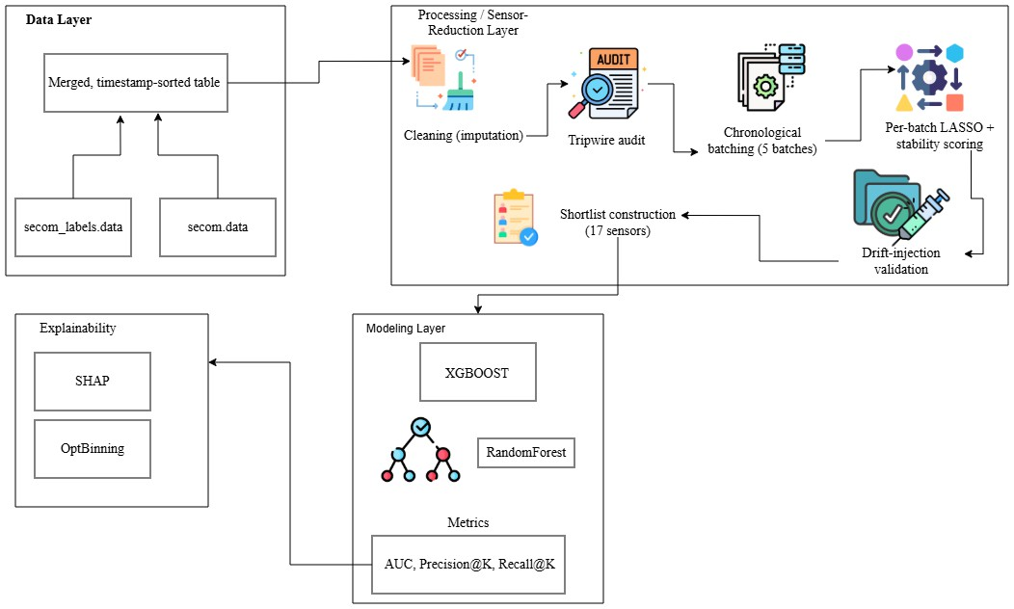

System Architecture
Input
590 Sensor Readings + Labels Chronologically Sorted Data
Data Processing
Median Imputation Tripwire Sensor Audit Chronological Batching (5)
Sensor Selection
LASSO Feature Selection Stability Score Calculation Drift Validation
17-Sensor Shortlist
Model Training
XGBoost & Random Forest SMOTE (Training Only) Chronological Train/Test Split
Explainability
SHAP Feature Importance Risk Bin Generation
Key Techniques
Chronological Batching – Prevents data leakage. LASSO Stability Selection – Selects consistent sensors. Tripwire Audit – Preserves critical rare sensors.
SHAP Analysis – Explains model predictions.

Slide 7

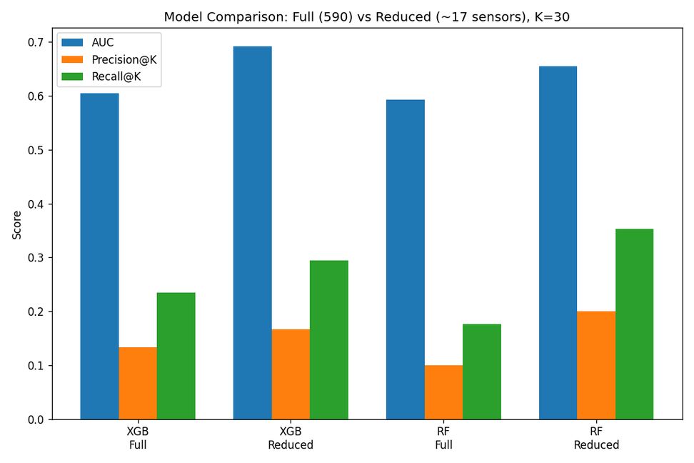
Model Performance
Model | Sensor Set | AUC | Precision@30 | Recall@30
XGBoost | 590 | 0.605 | 0.133 | 0.235
XGBoost | 17 | 0.692 | 0.167 | 0.294
Random Forest | 590 | 0.593 | 0.1 | 0.176
Random Forest | 17 | 0.655 | 0.2 | 0.353
RESULTS
Highlight
17-sensor model outperformed the full 590-sensor model.

Slide 8
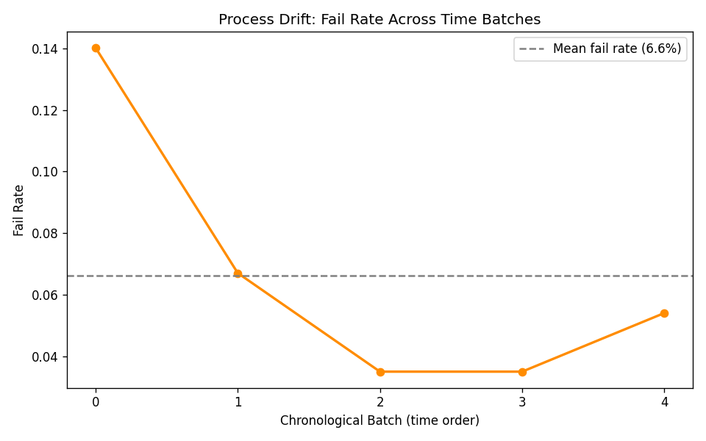

Process Drift
Purpose: Show why a drift-aware approach is needed.
Content
Failure rate changes across chronological batches, confirming process drift. Mention that failure rate drops from 14.0% to 3.5%, then rises to 5.4%.
Batch | Rows | Failures | Fail Rate
0 | 314 | 44 | 14.00%
1 | 313 | 21 | 6.70%
2 | 313 | 11 | 3.50%
3 | 313 | 11 | 3.50%
4 | 314 | 17 | 5.40%

Slide 9
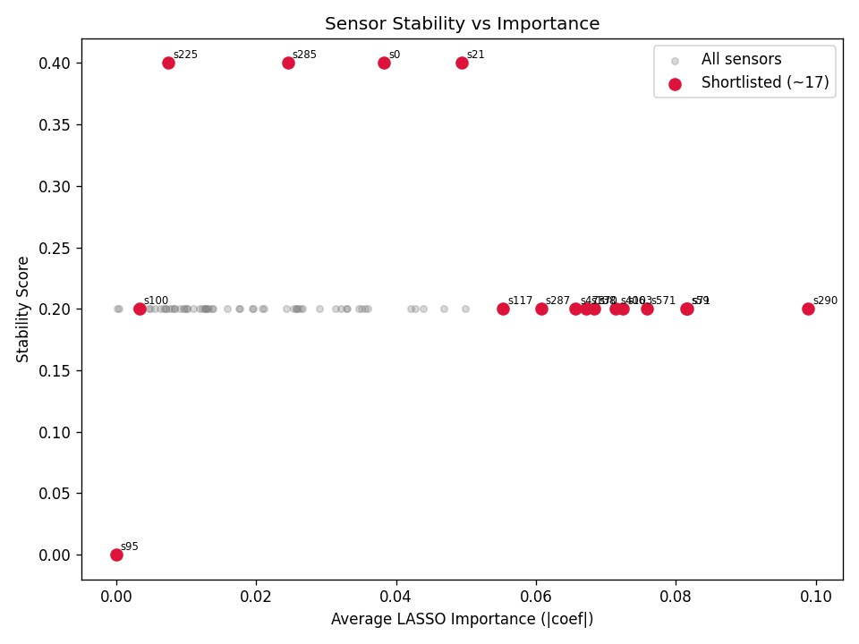
Sensor Stability
Purpose: Show how your method selected sensors.
Content
No sensor exceeded a stability score of 0.4.
Top stable sensors:
sensor_0, sensor_21, sensor_225, sensor_285, sensor_95 was retained through the Tripwire Audit despite a stability score of 0.0.

Slide 10
Drift Validation
Purpose: Prove that the stability score actually responds to drift.
Condition (sensor_21) | Stability Score | Selected?
Before injection | 0.4 | Yes
After noise injection | 0.2 | No

Slide 11
Explainability
Purpose: Show that the model is interpretable.
Rank | Sensor | Mean |SHAP|
1 | sensor_59 | 0.143
2 | sensor_290 | 0.051
3 | sensor_287 | 0.051
4 | sensor_103 | 0.04
5 | sensor_95 | 0.039
Key Finding
sensor_59 risk range: 0.9% → 19.0% failure rate

Slide 12
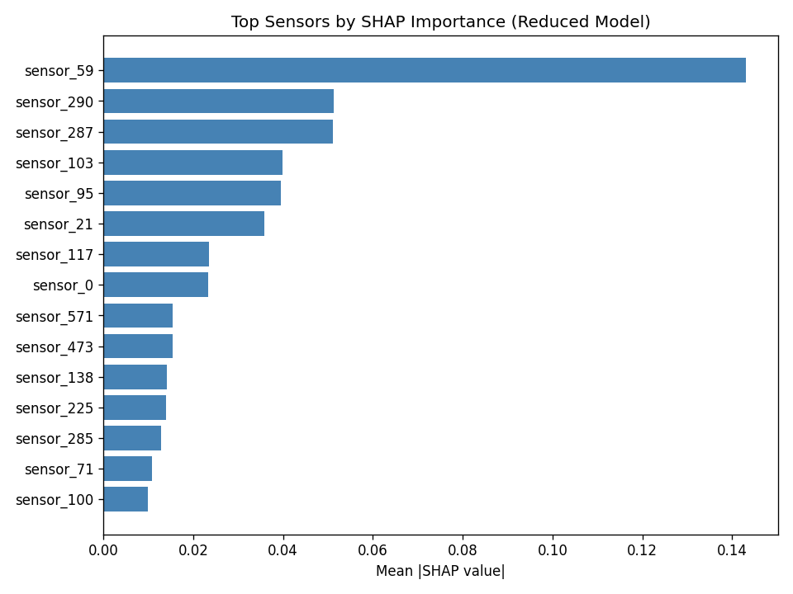
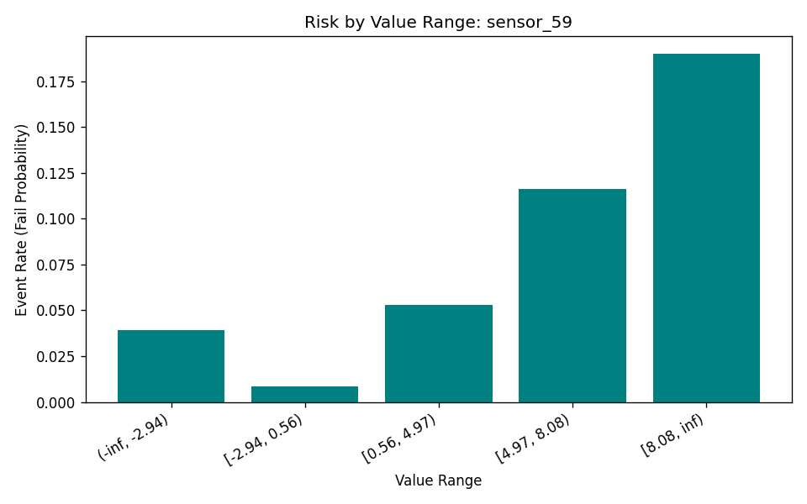

Explainability
Observed failure rate by value range for sensor_59, the top-ranked sensor by SHAP importance
Mean absolute SHAP value per sensor, reduced model, ranked highest to lowest.

Slide 13

Key Findings
17 sensors outperformed all 590 sensors across AUC, Precision@30, and Recall@30. Process drift exists, with failure rates changing from 14.0% → 3.5% → 5.4% across time. No sensor remained consistently predictive (maximum stability score = 0.4).
Random Forest achieved the biggest improvement, doubling both Precision@30 and Recall@30.
Drift injection validated that the stability score responds to changes in sensor behavior (0.4
→ 0.2).
Tripwire Audit preserved critical sensors, retaining sensor_95, which later ranked 5th in SHAP importance.
Core Takeaway
A drift-aware 17-sensor shortlist improved prediction accuracy while reducing the sensor set by ~97%.

Slide 14

Conclusion
YieldLens cuts sensor monitoring from 590 to 17 by selecting sensors based on predictive stability across time, not importance on one snapshot. The reduced set beat the full set across both models and all metrics, and a drift-injection test confirmed the stability score genuinely tracks drift. A separate tripwire audit recovered a key sensor that stability selection alone would have missed — showing one selection method isn't enough on its own.
Future Work
Test on additional fabrication datasets beyond SECOM
Add correlation-clustering to catch multi-sensor redundancy
Evaluate stability across more chronological splits as more data becomes available

Slide 15
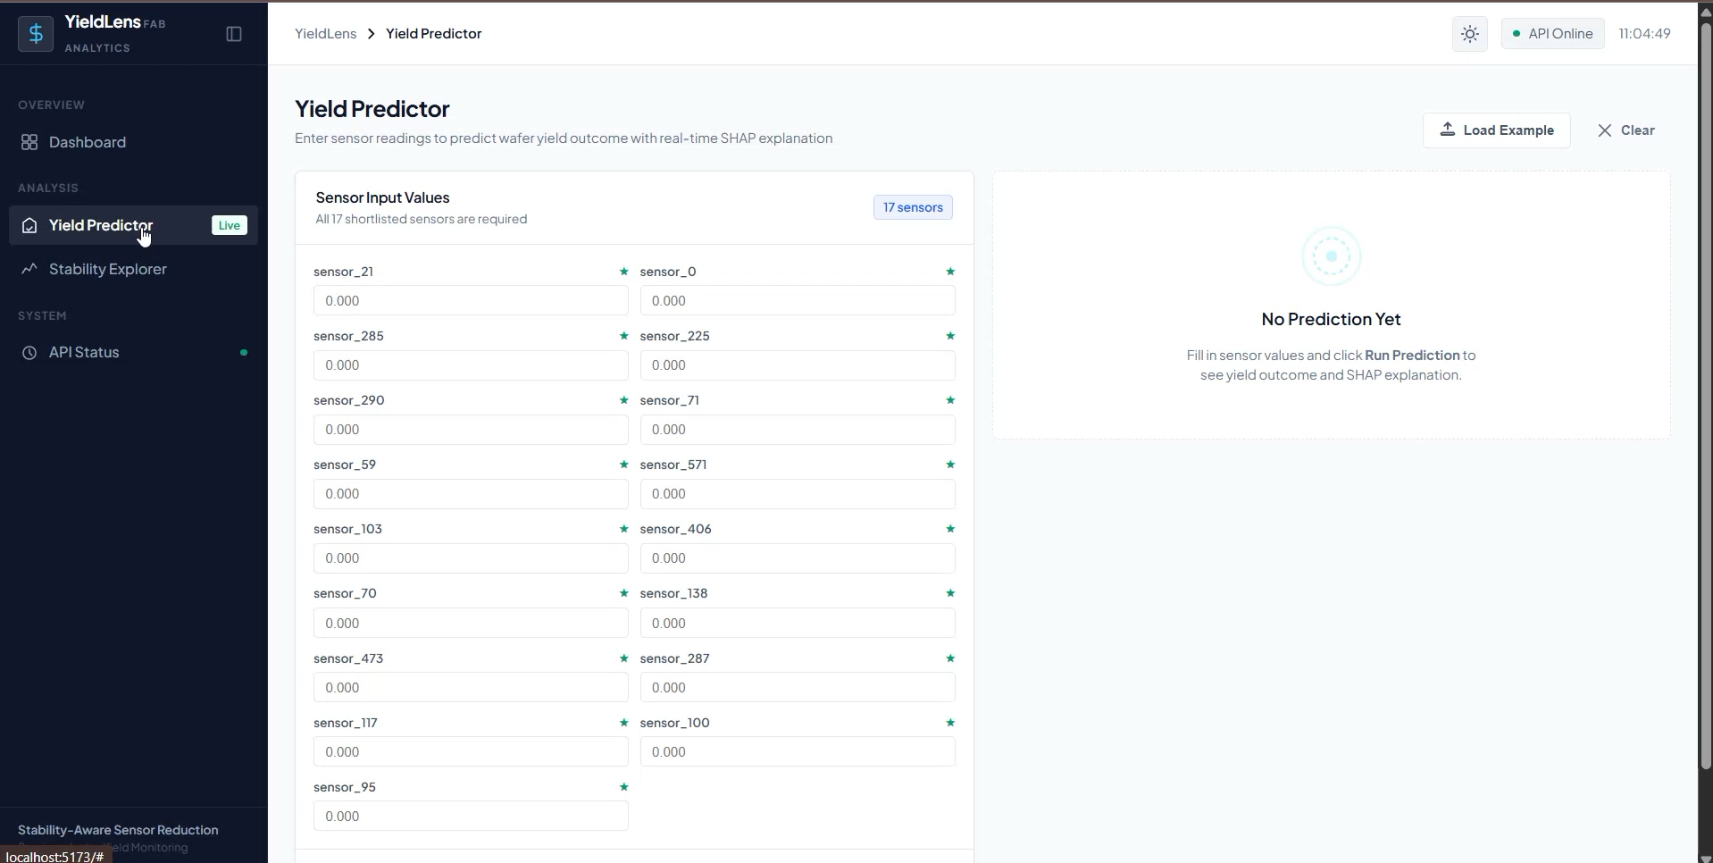
DEMO

Slide 16
Any Questions?
Q&A

Slide 17

Thank You

